Slide 1
Project 2
Develop Pitch Deck
For the content

Slide 2


Slide 3
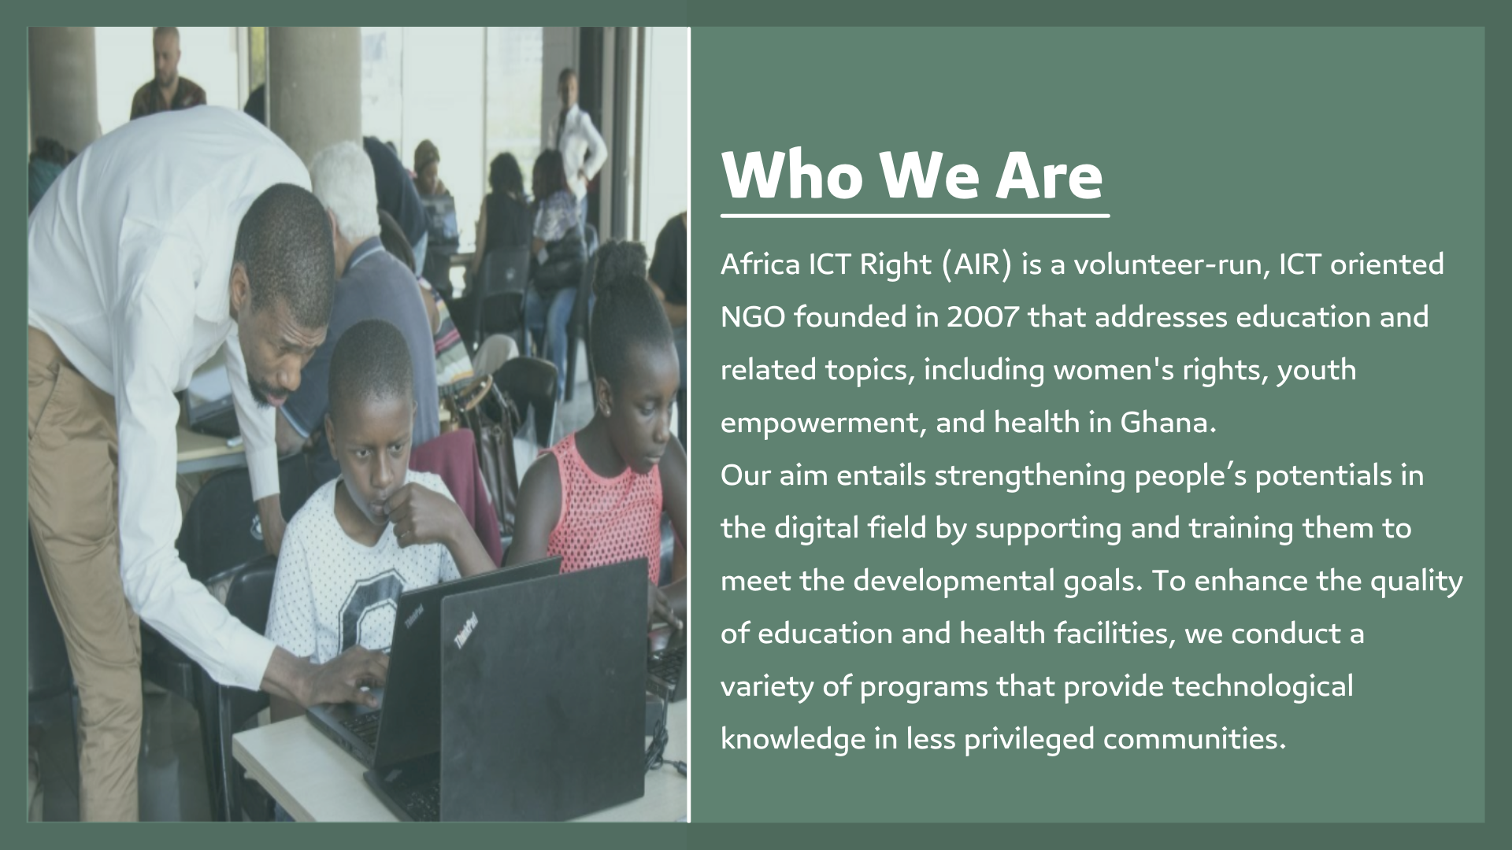

Slide 4
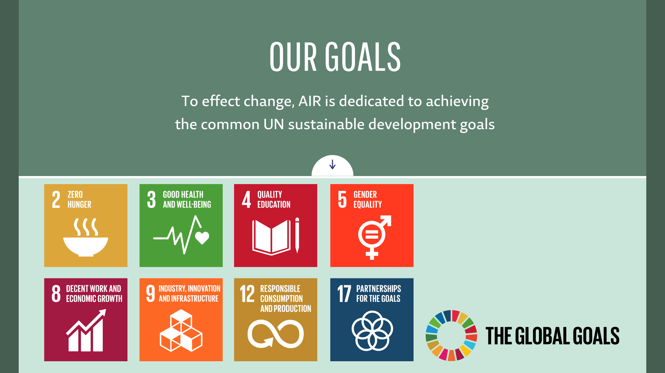

Slide 5
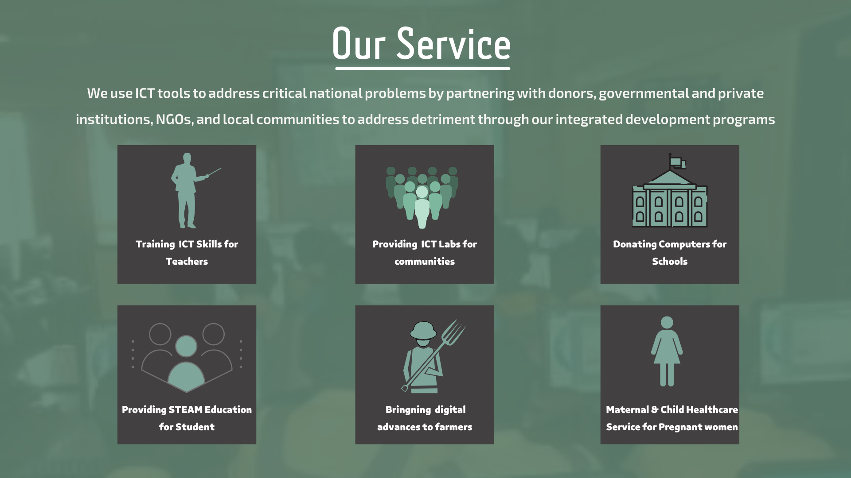

Slide 6






KEY ISSUES
Lack of Access to ICT Infrastructure
Lack of Healthcare Services
Limited Technical Teaching
Food security challenges
Digital Gender Gap

Slide 7
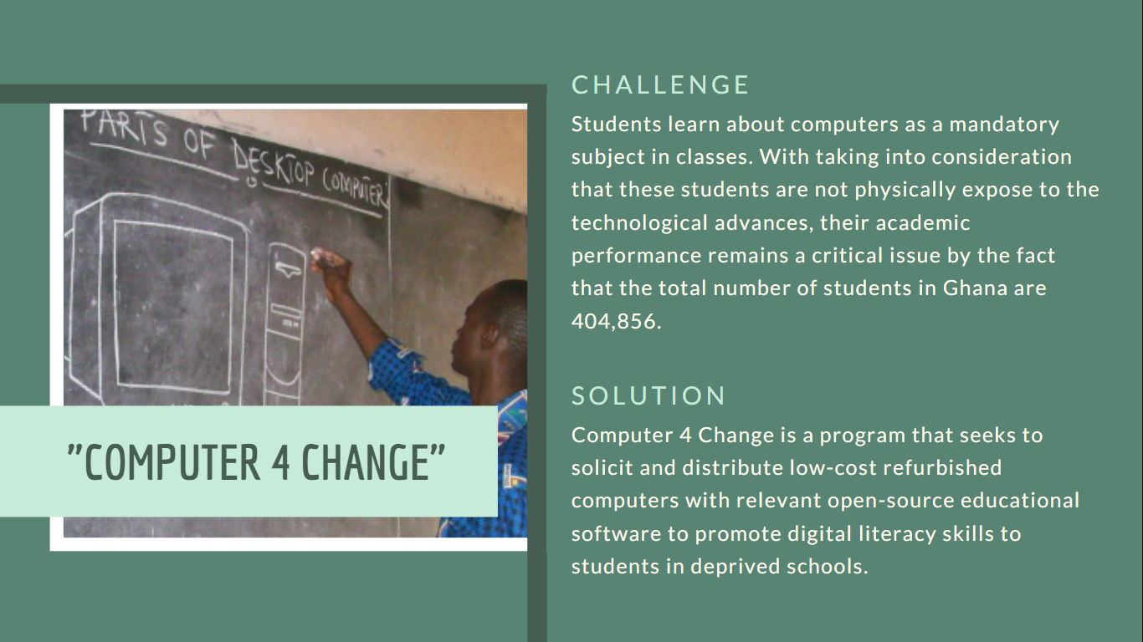

Slide 8
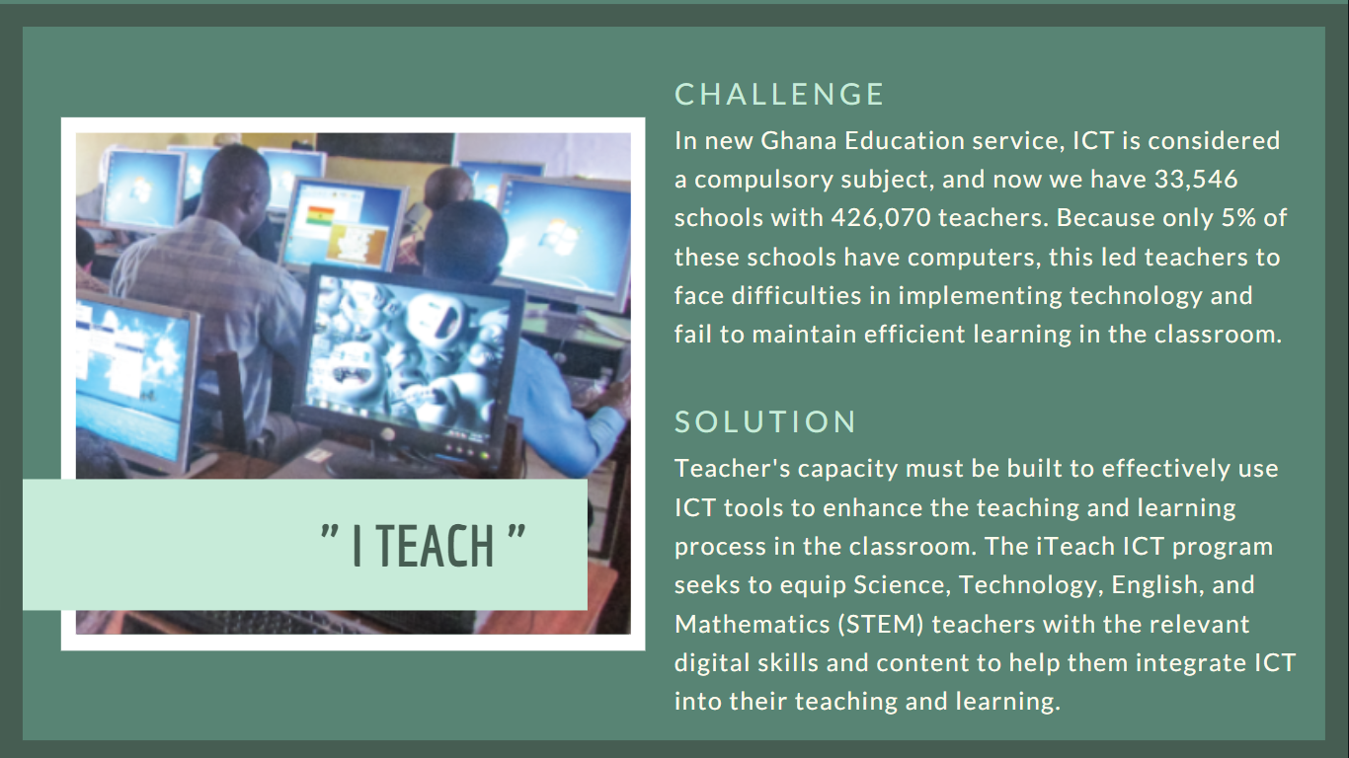

Slide 9
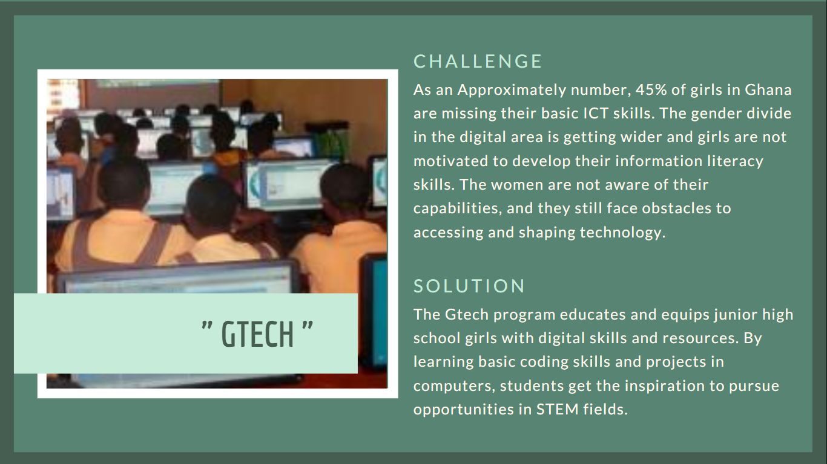

Slide 10
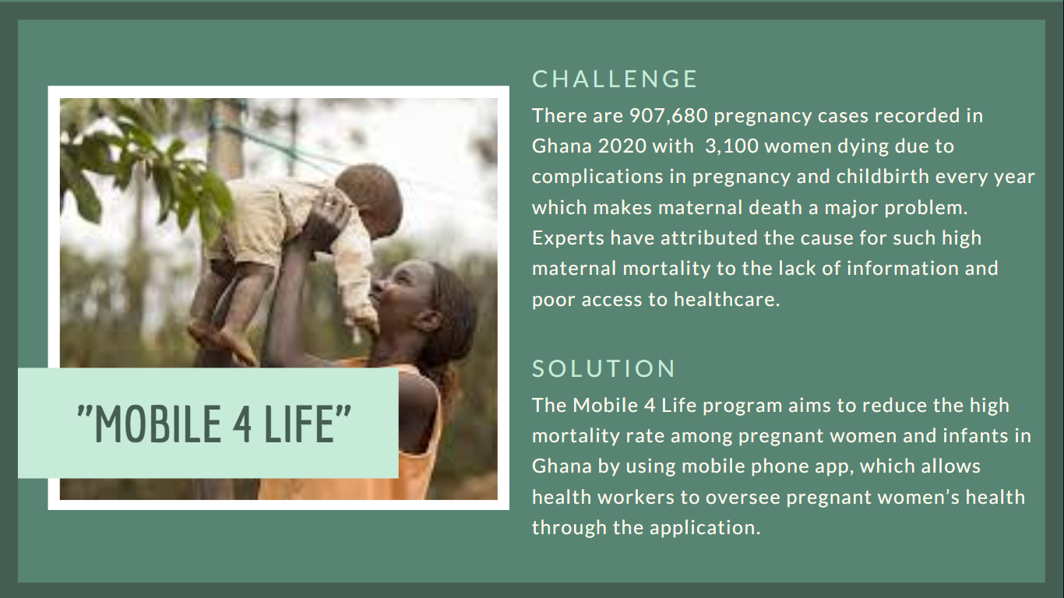

Slide 11
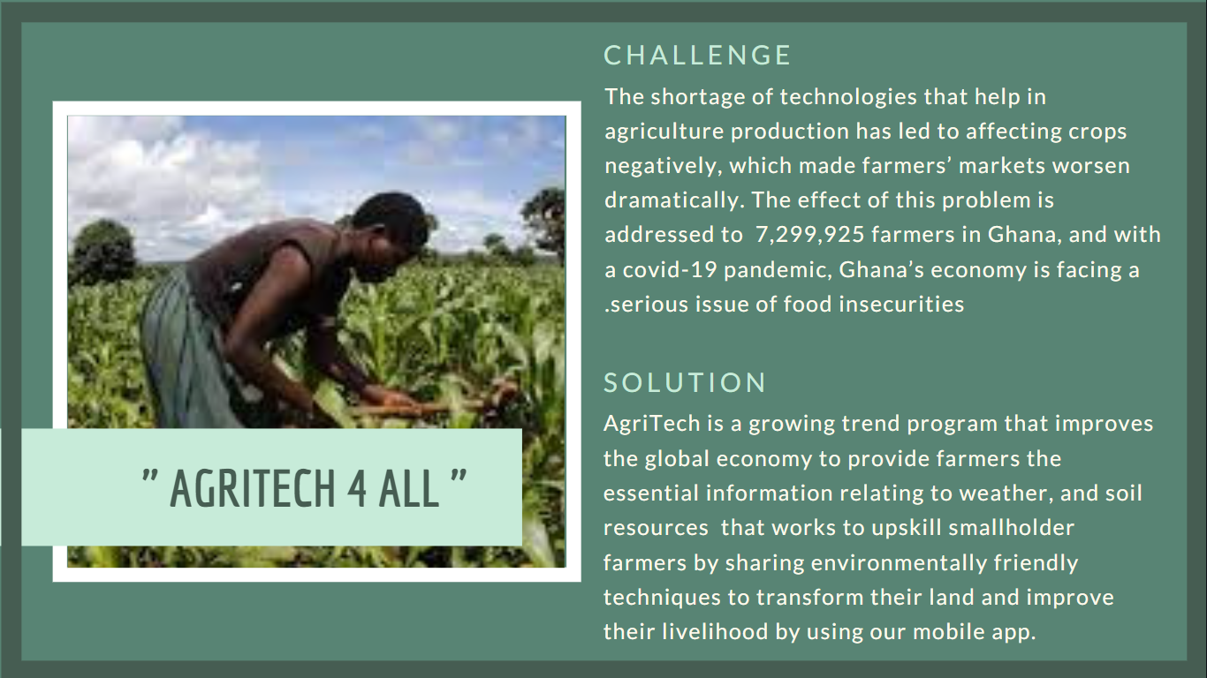

Slide 12
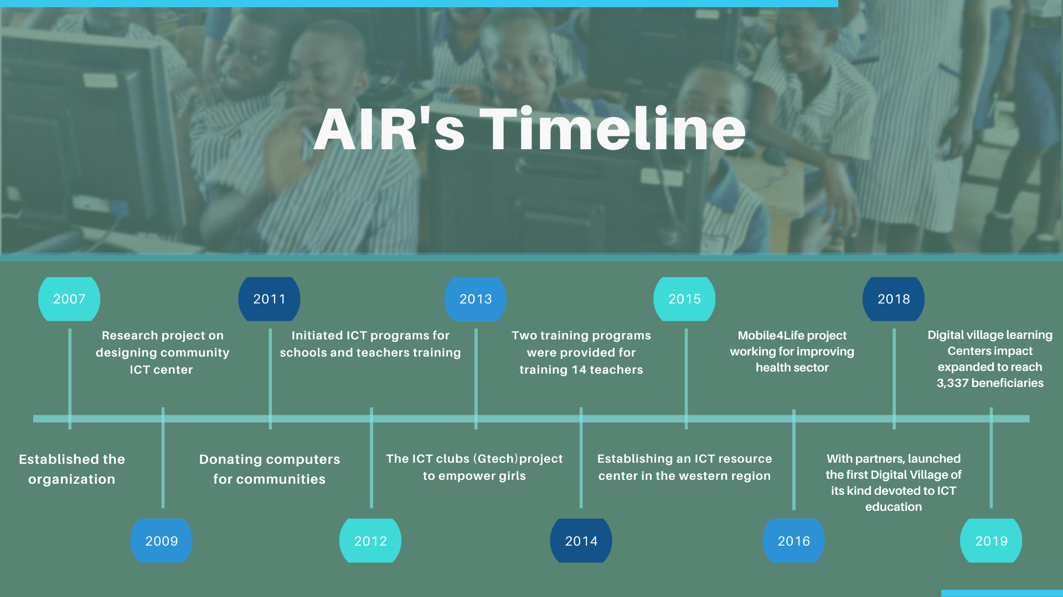

Slide 13

 | 2022 | 2023 | 2024 | 2025
Income
Donation Other Income | 1500 8800 | 6700 800 | 9080 1000 | 4455 900
Expenses
General & Administrative Marketing Operation Other Expenses Total Operating Expenses | 7000 900 500 3444 5666 | 7666 900 1500 1300 350 | 9000 6700 900 800 400 | 5677 4500 1000 1190 750
Outcomes
Total PC | 80 | 900 | 1300 | 800
Total Projects | 5 | 7 | 12 | 19

Slide 14

Project Name
Target
Project Cost
Peer Lab Tutoring
Classroom of the Future
Tower Lab
Right to Read
Haller Farmer App
Mobile 4 Life
Digital Village
I Teach ICT
Computer 4 Change
 | 2022 | 2023 | 2024 | 2025
Students | 7000 | 8000 | 9000 | 9800
Students | 7000 | 8000 | 9000 | 9800
Students | 1900 | 1200 | 1200 | 5400
Students | 9000 | 7000 | 8000 | 7000
Farmers | 7000 | 8000 | 5000 | 300
Health Personals & Pregnant Women | 8000 | 300 | 400 | 9800
Students, Teachers and Youth | 7000 | 8000 | 9000 | 9800
Teachers | 1500 | 7000 | 300 | 7600
Junior High Schools | 9000 | 3500 | 7000 | 8000

Slide 15
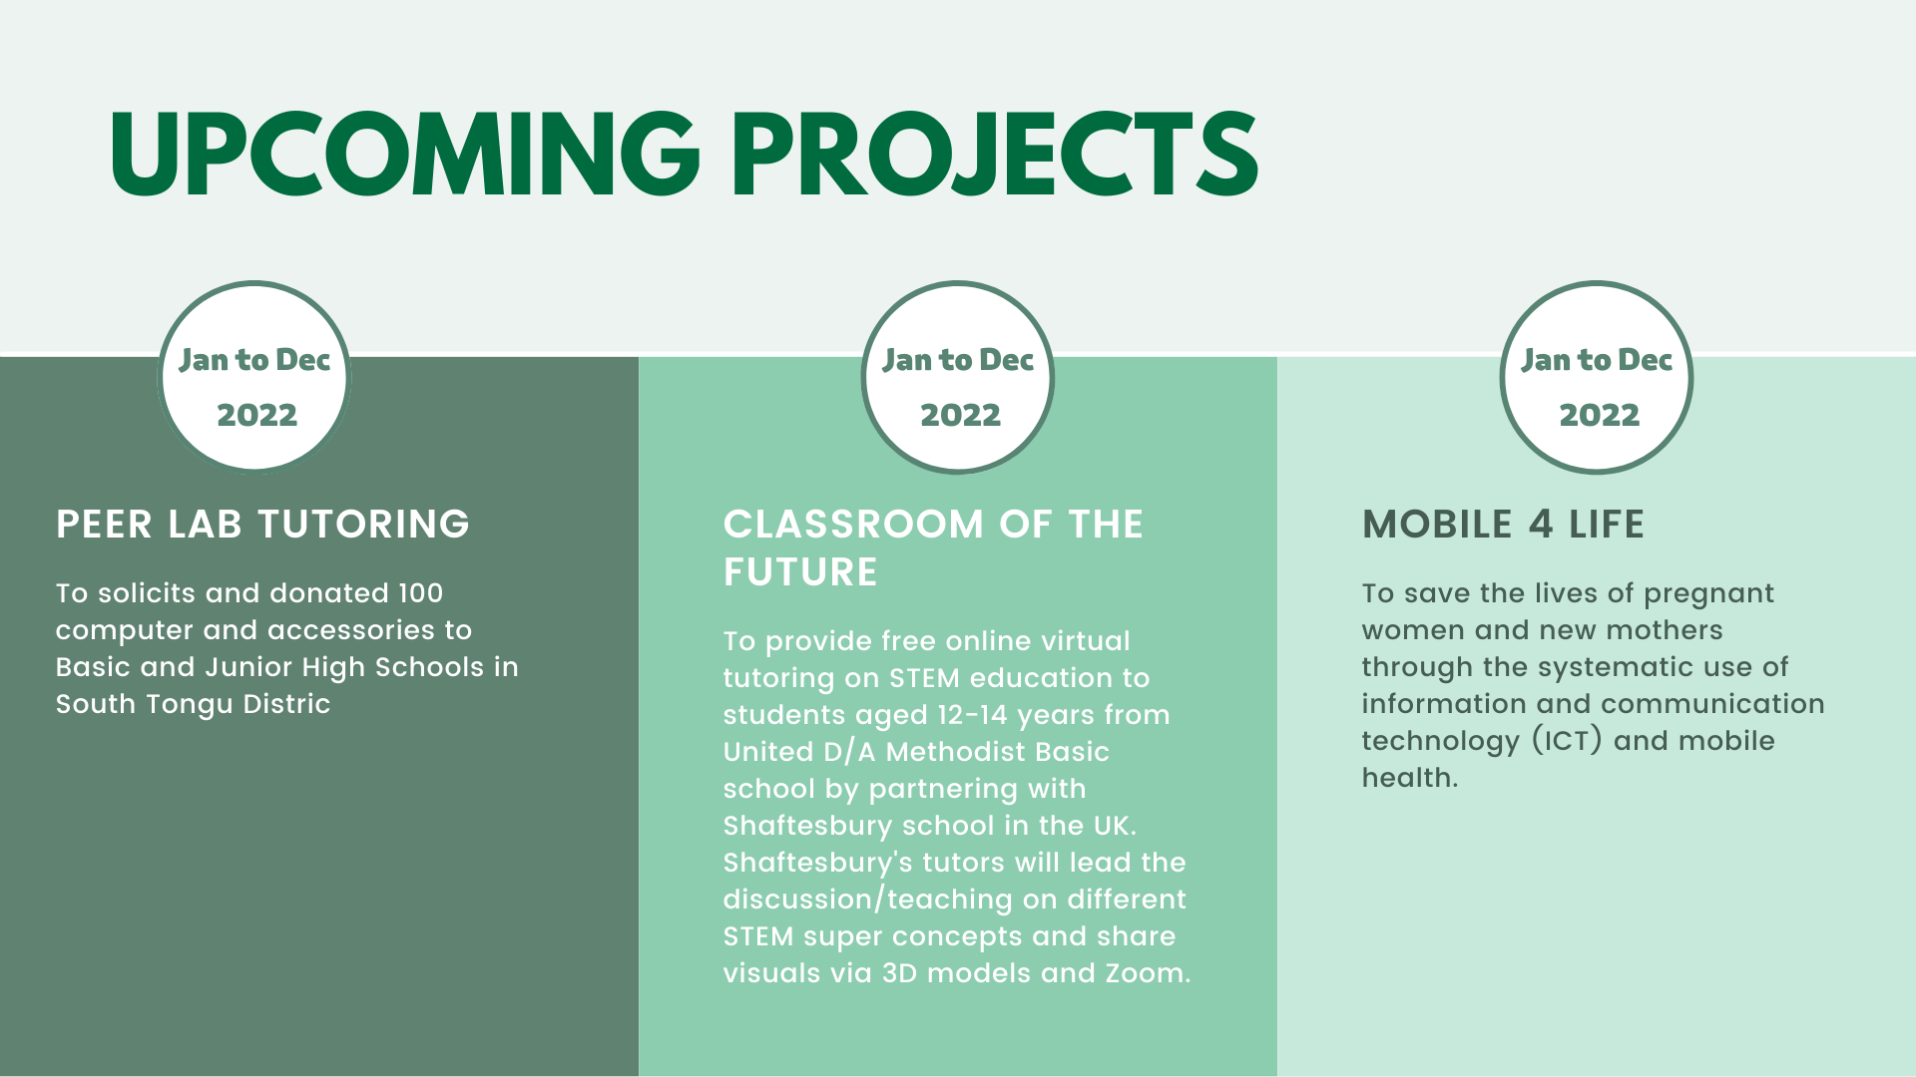

Slide 16
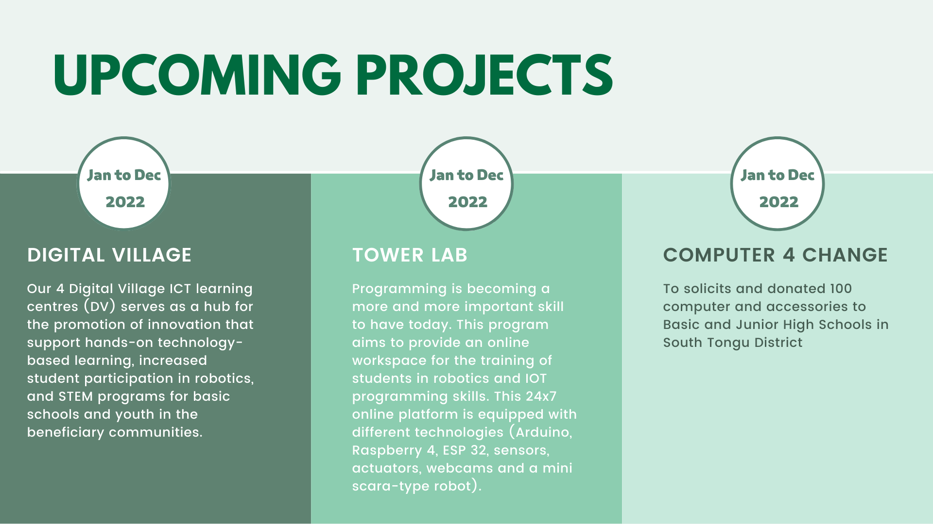

Slide 17
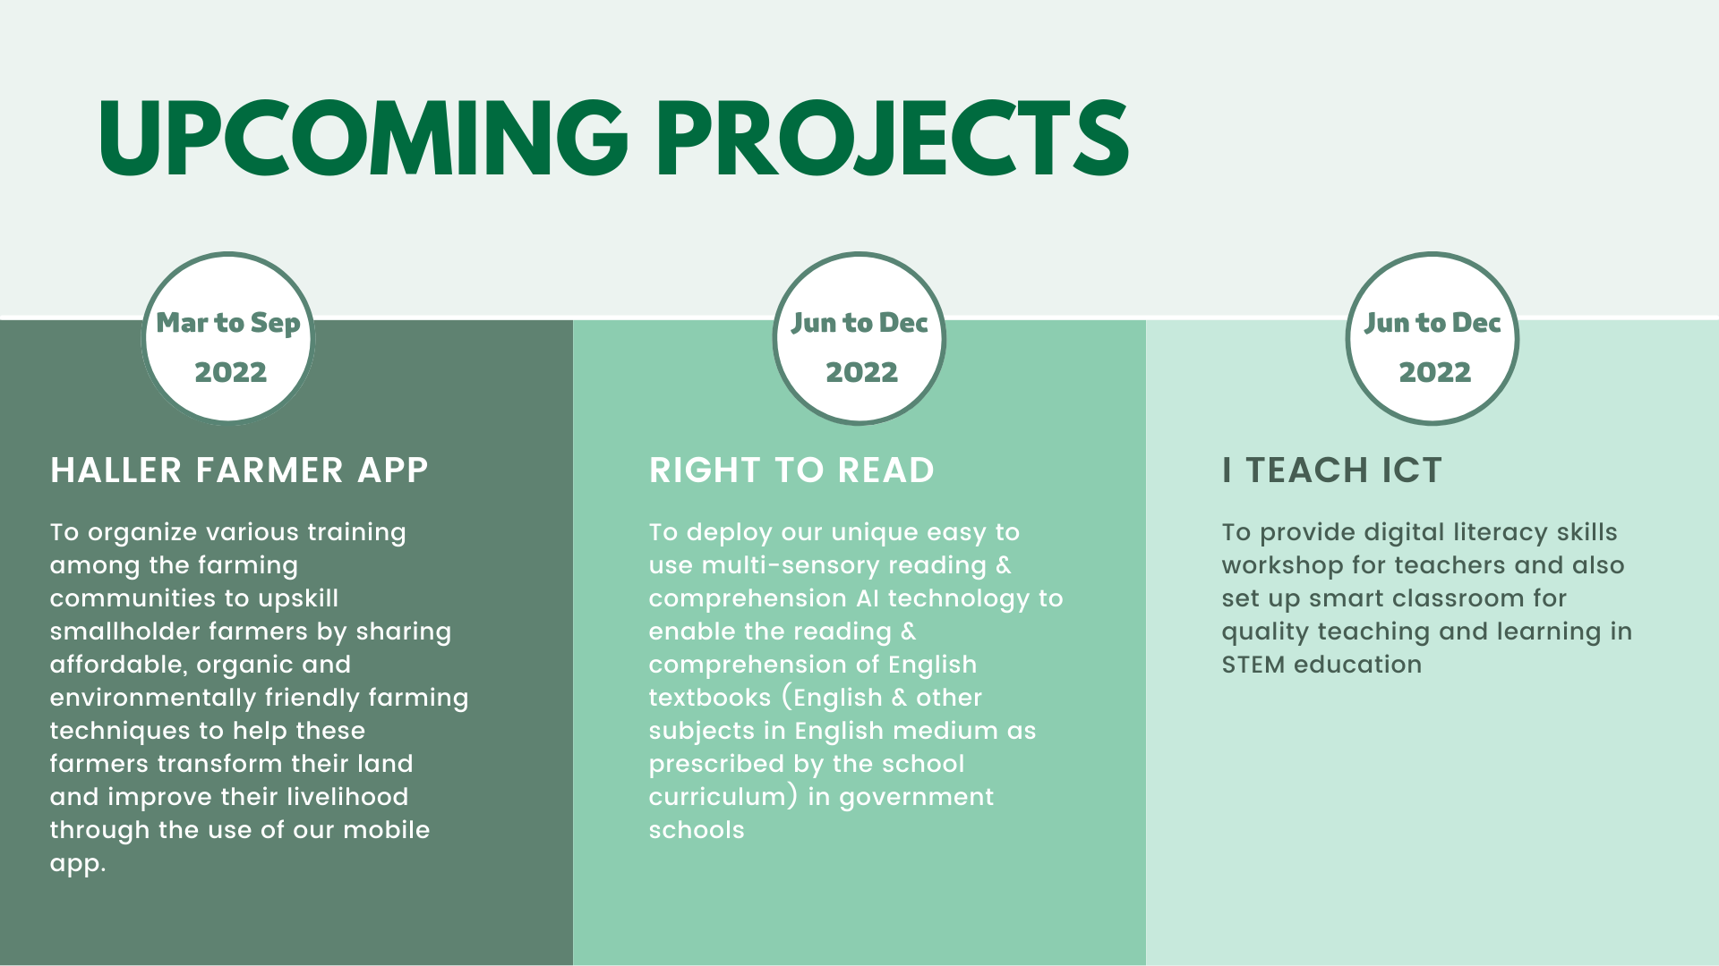

Slide 18
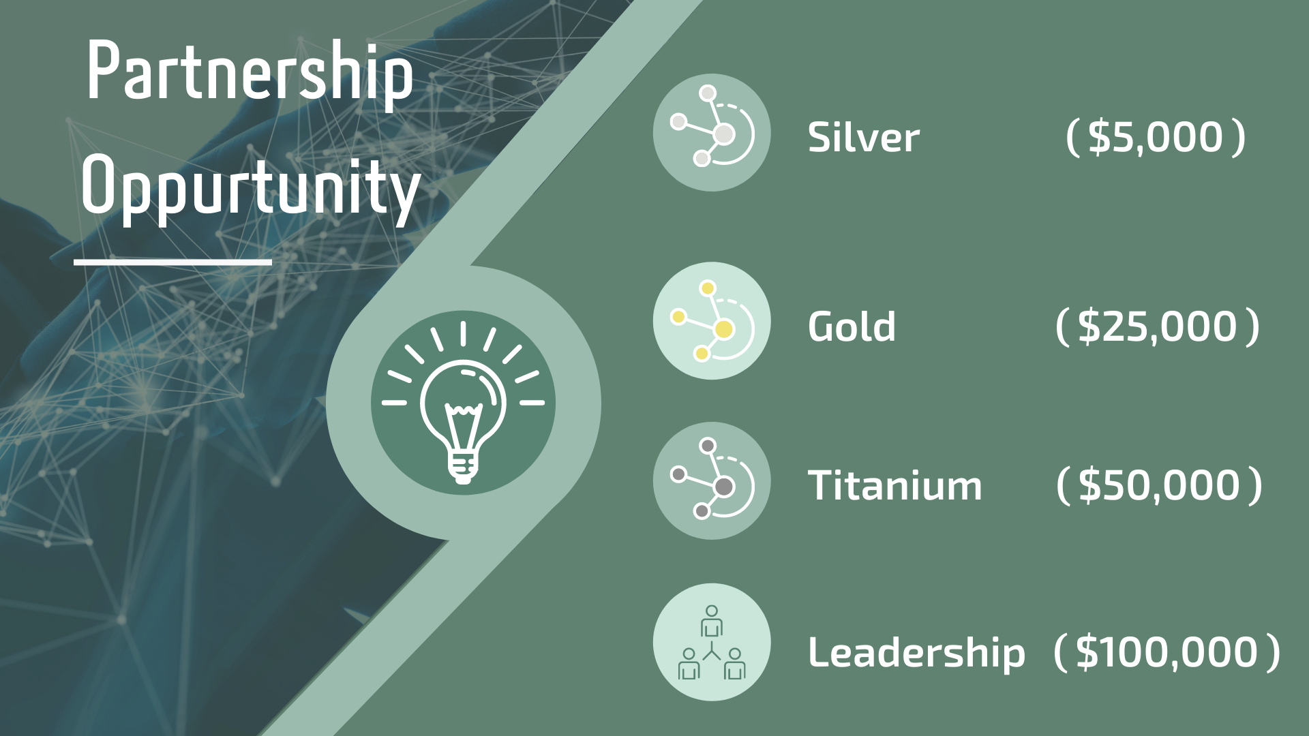

Slide 19
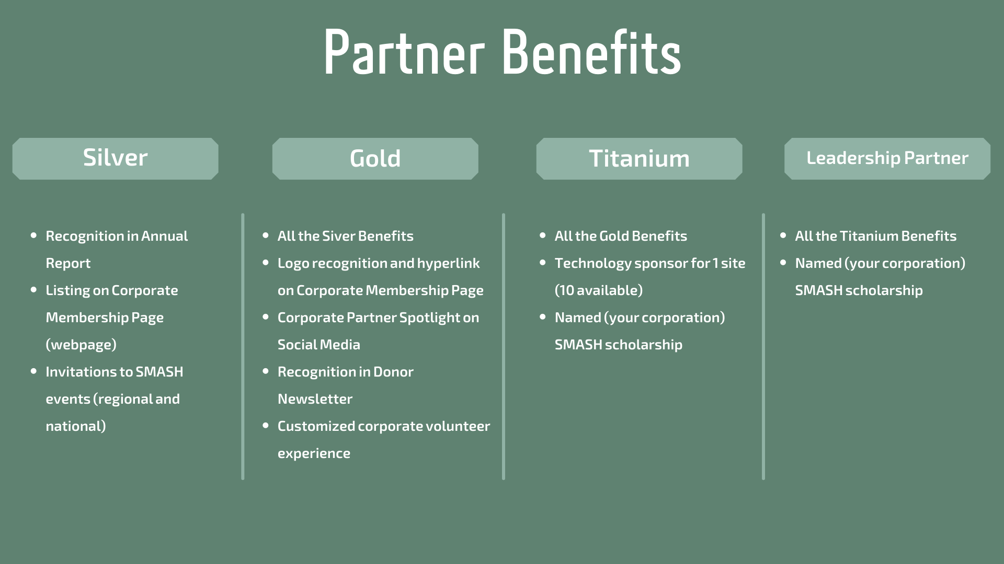

Slide 20
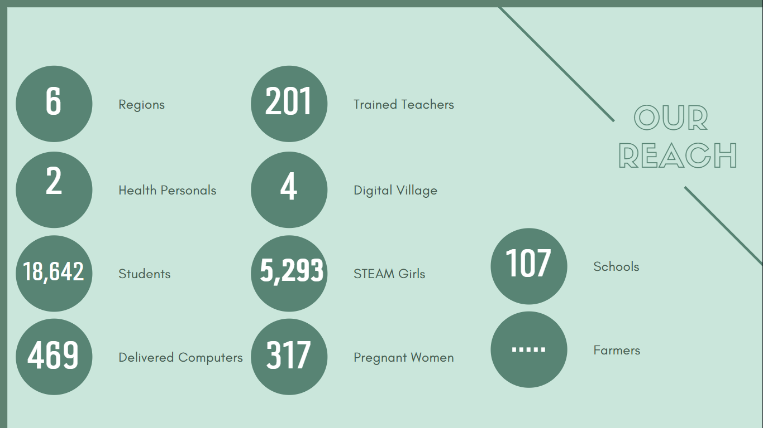

Slide 21
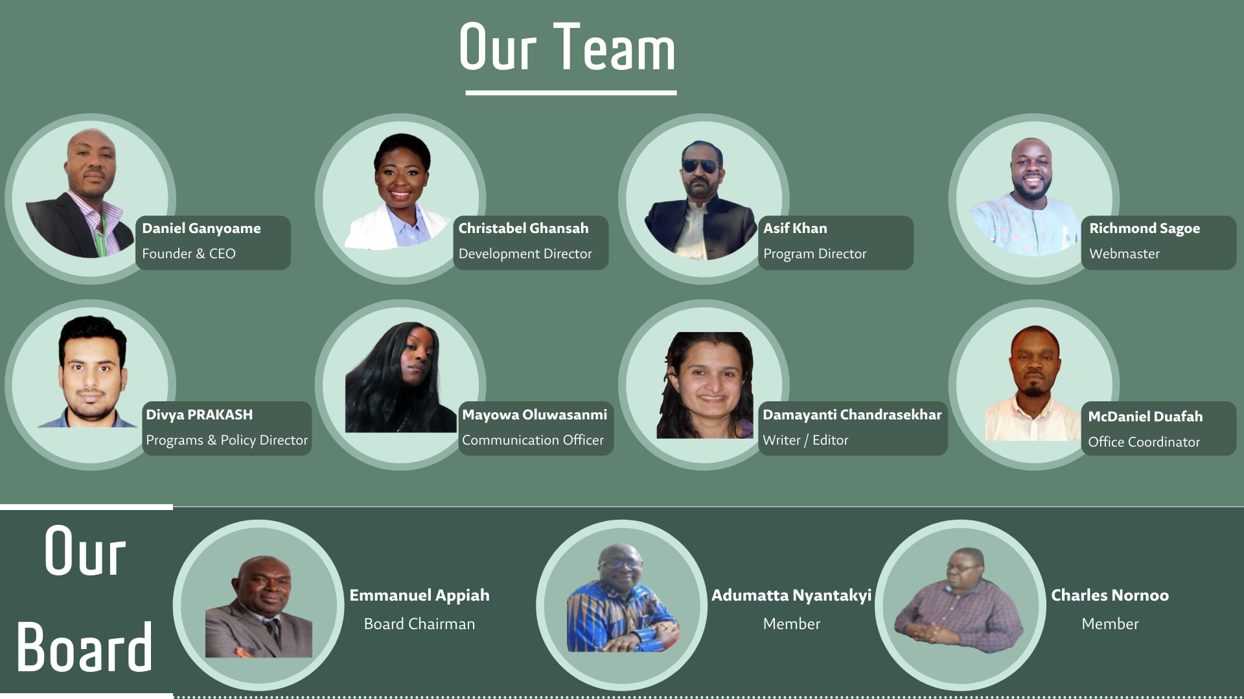

Slide 22
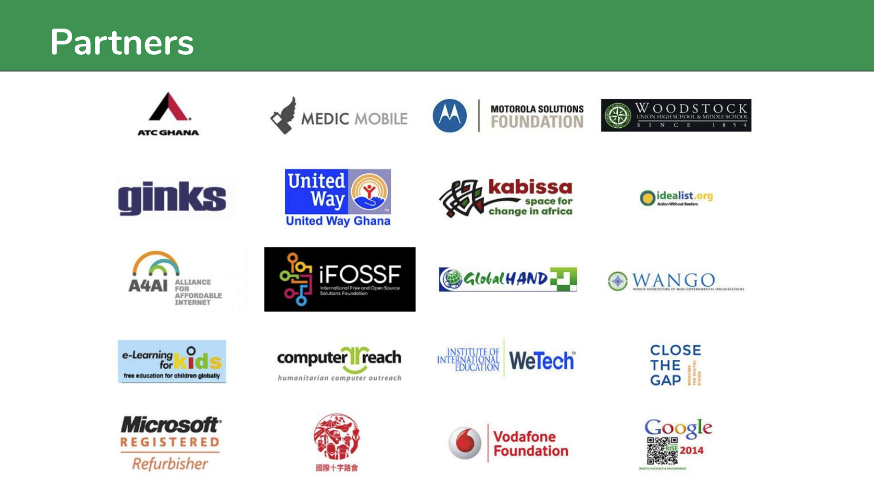
Partners
Partners
the same

Slide 23


Slide 24

Name:
Suhaila Alsheikhmubarak
Nada AlSalem
Budoor Alharbi

